Slide 1



Sponsorship Proposal
International Fashion Gateway 2026
sponsorship@ifg-ksa.com
www.ifg-ksa.com

Slide 2

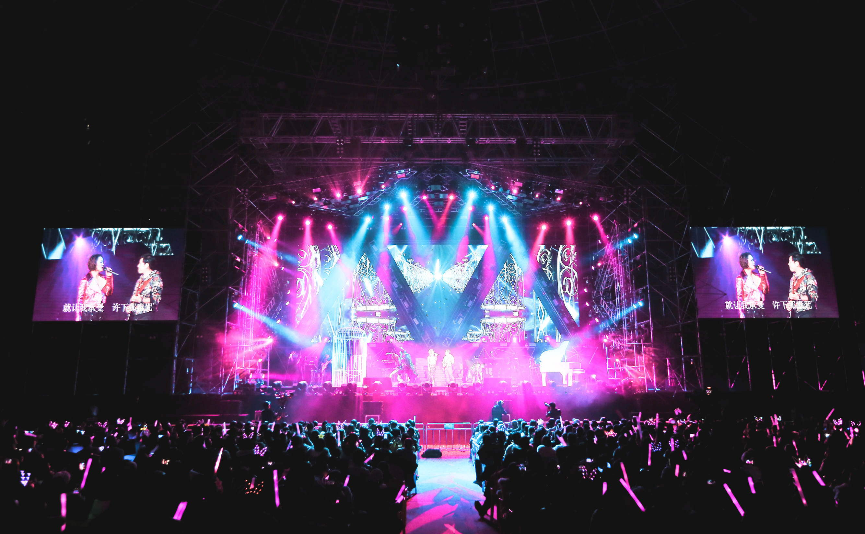
About the Event
We invite you to participate in the Saudi International Fashion Gateway (SIFG) 2026 – the definitive trade exhibition connecting international fashion brands, designers, and manufacturers with the booming Saudi and GCC markets. This is not just an exhibition; it is a strategic market-entry platform designed to facilitate orders, forge partnerships, secure investment, and establish long-term presence in the world's most promising emerging fashion economy.
Saudi Arabia, under Vision 2030, is transforming into a global fashion and luxury hub. With a consumer base that is young, digitally-savvy, and has one of the highest per-capita spending rates on fashion globally, the opportunity for international brands is unprecedented.

Slide 3
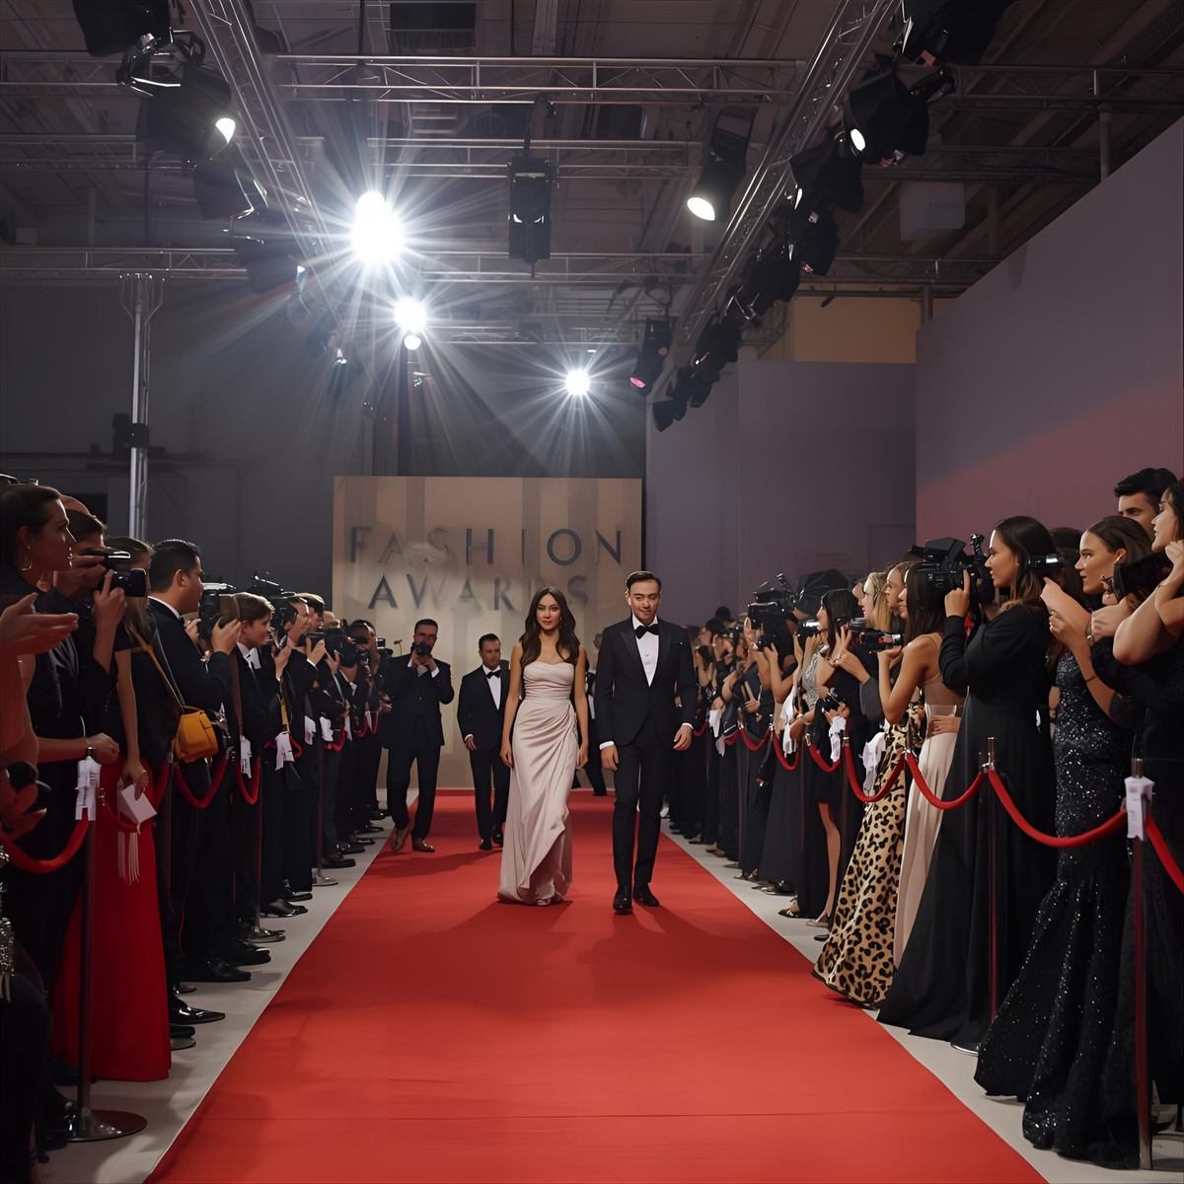
The International Fashion Gateway (IFG) 2026 is not just an exhibition—it is the definitive platform connecting global fashion innovation with the booming Saudi and GCC markets. As Saudi Arabia accelerates its transformation under Vision 2030, the fashion sector is poised to become a global hub for luxury, innovation, and investment.
Sponsoring IFG 2026 means aligning your brand with:
01.
A $20+ billion fashion market projected for 2026
02.
The world’s fastest-growing luxury and modest fashion demand.
Why Sponsor IFG 2026?
03.
A government-backed initiative supported by the Saudi Fashion Commission.
04.
A curated audience of elite buyers, investors, and industry leaders.
By partnering with us, you will gain unparalleled access to the heart of Saudi Arabia’s fashion revolution while amplifying your brand’s visibility, credibility, and influence across the region.

Slide 4
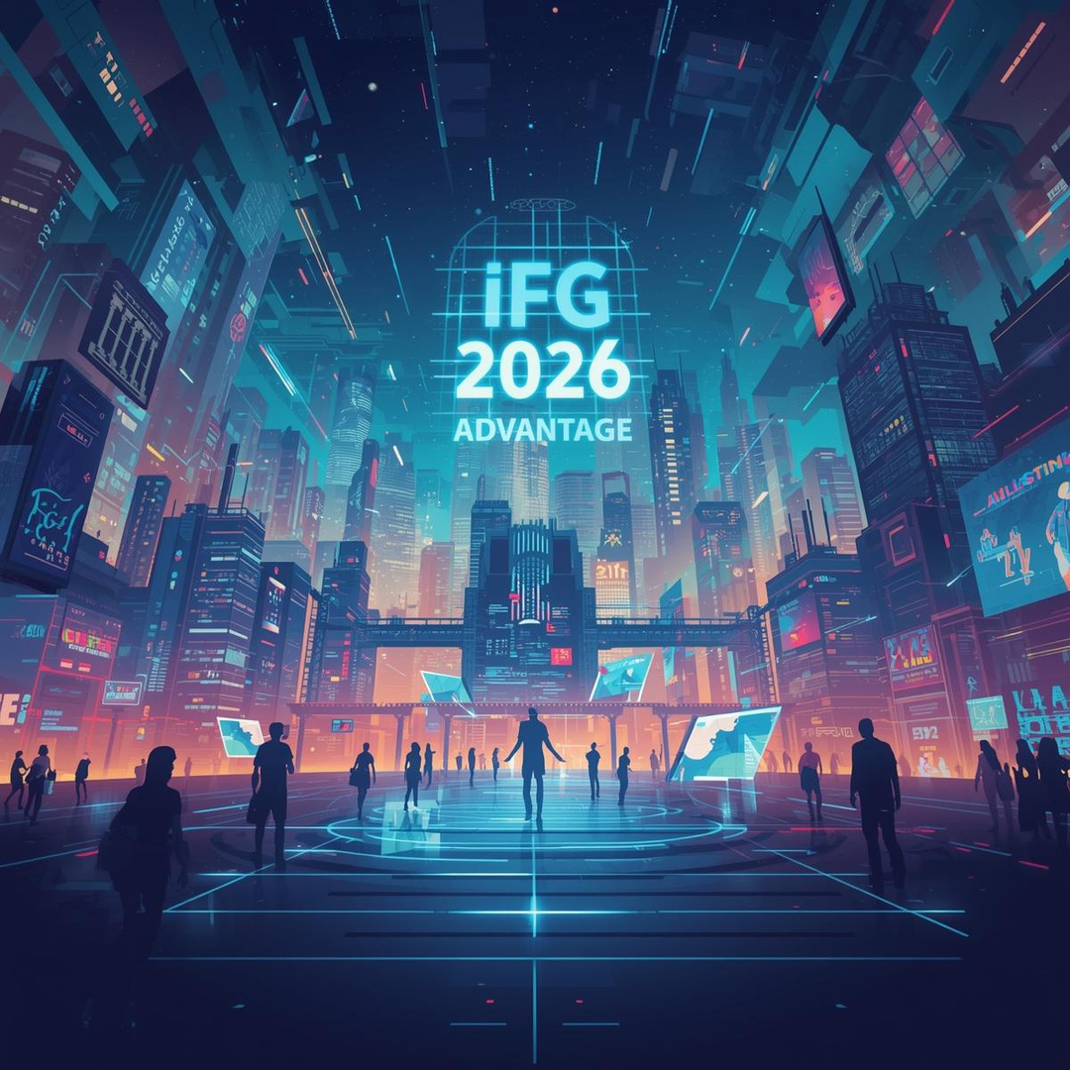
The IFG 2026 Advantage:
What Makes This Event Unique?
A. Unmatched Market Access
IFG 2026 is designed as a strategic gateway for international brands to enter and thrive in Saudi Arabia. Our platform offers:
Pre-vetted buyers
·from the GCC’s top retail chains, e-commerce giants, and franchise investors.
Dedicated matchmaking
with Saudi investors, real estate developers, and venture capitalists.
Exclusive networking
with government bodies, including the Saudi Fashion Commission.

Slide 5

The IFG 2026 Advantage:
What Makes This Event Unique?
B. Exclusive Programming for Maximum Impact
Beyond the exhibition floor, IFG 2026 features high-profile events that attract media, influencers, and decision-makers:
The “Best of IFG” Curated Ramp Walk Show
A prime-time runway event showcasing the top 5 collections, judged by a panel of Saudi fashion editors and influencers.
The IFG Excellence Awards Ceremony
A prestigious gala dinner recognizing excellence across six award categories, from bridal wear to sustainable design.
These events are not just add-ons—they are integral to the attendee experience and offer sponsors premium visibility.

Slide 6
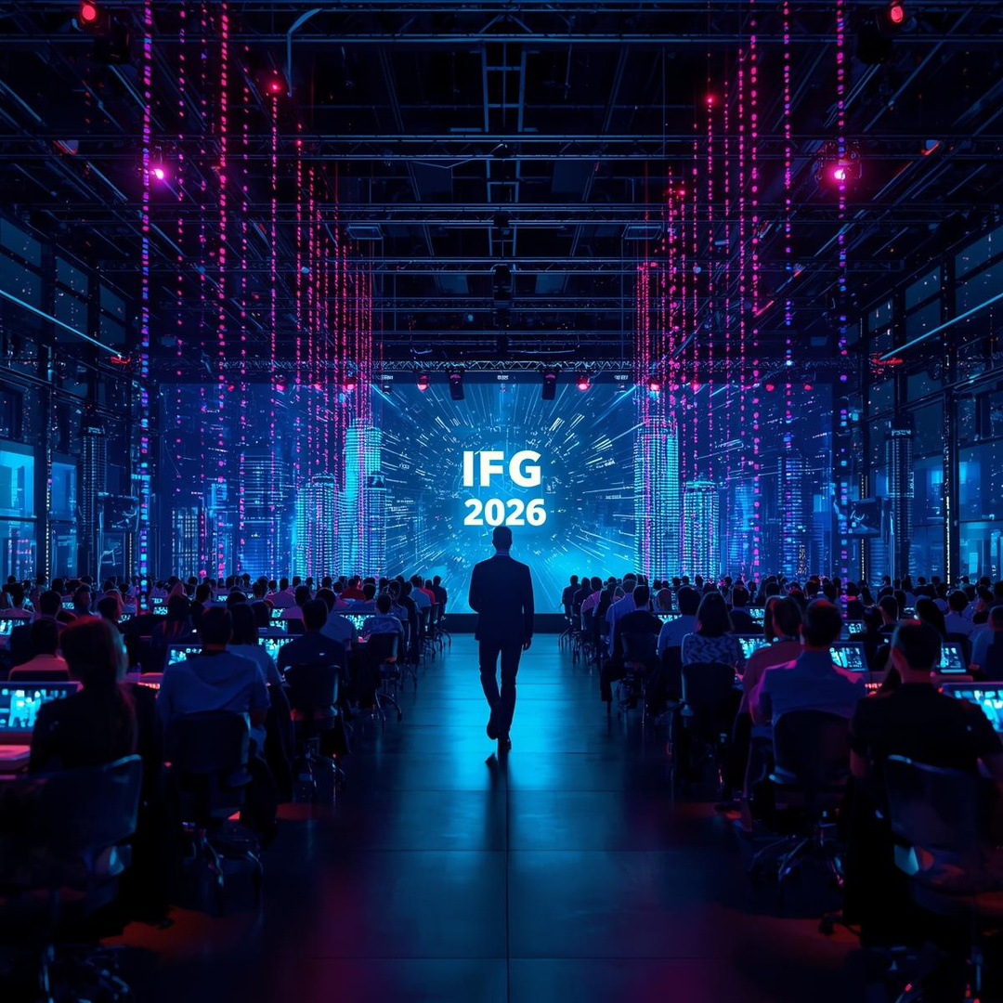
The IFG 2026 Advantage:
What Makes This Event Unique?
C. Regional Tailoring for Global Brands
IFG 2026 offers region-specific value propositions, ensuring relevance for brands from:
Europe
(luxury and contemporary fashion).
South Asia
(bridal, craftsmanship, and textiles).
The GCC
(Bridal, modest fashion, cultural fusion, and haute couture).
The Americas and East Asia
(lifestyle, streetwear, and innovation).

Slide 7
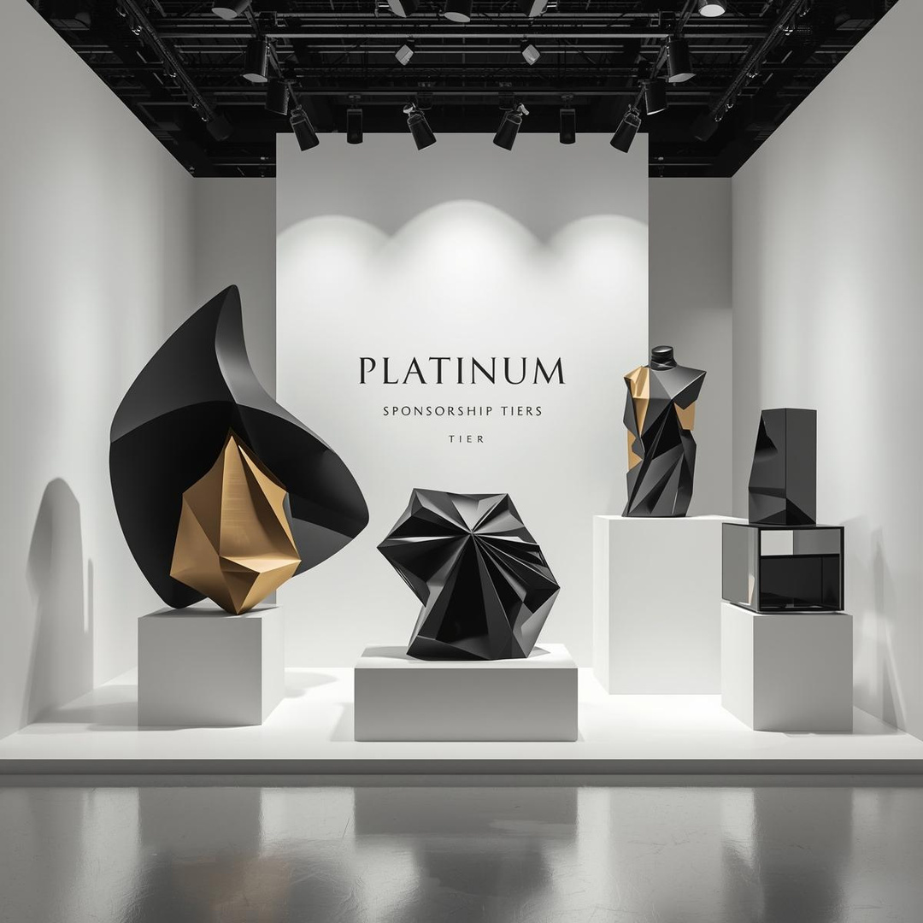

Sponsorship Tiers & Benefits
We offer tiered sponsorship packages designed to meet diverse branding, networking, and business objectives.
Platinum Sponsor | Exclusive Investment
  ·Naming rights: “IFG 2026 Presented by [Your Brand]”
  ·Keynote speaking slot at Investment Forum
  ·Prime logo placement on all event materials
  ·VIP table at Awards Gala (10 guests)
  ·Dedicated feature in all press releases
  Exclusive lounge access
Ideal For
Global luxury brands, financial institutions, and flagship investors seeking dominant visibility.

Slide 8
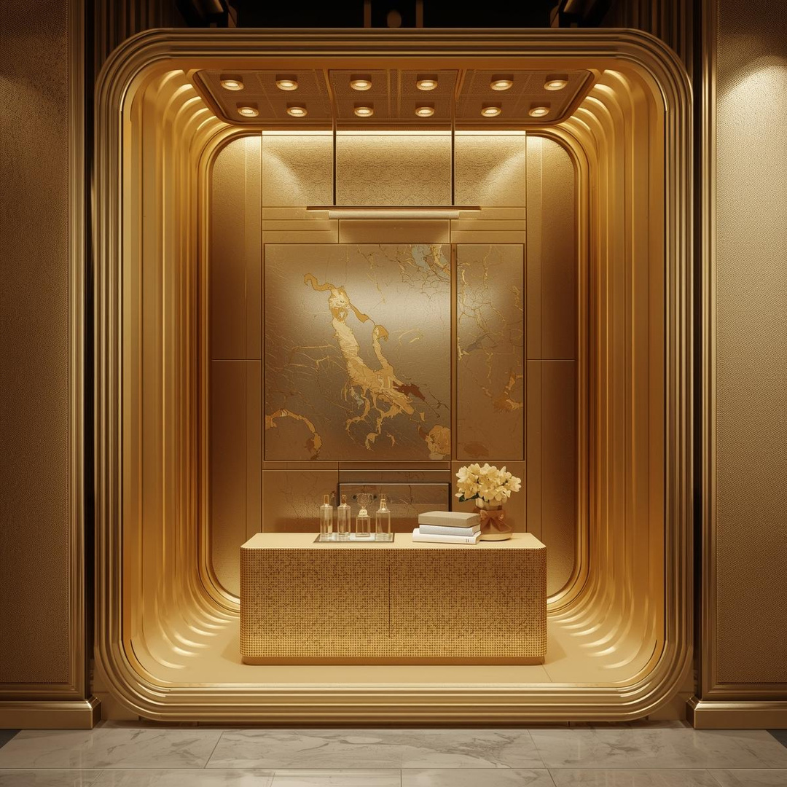
Sponsorship Tiers & Benefits
We offer tiered sponsorship packages designed to meet diverse branding, networking, and business objectives.
Gold Sponsor | High Investment
  ·Main stage branding at Runway Shows & Awards
  ·5 pre-scheduled meetings with top buyers/investors
  ·Logo on event website, app, and signage
  ·4 VIP passes to Awards Gala
  Featured interview in event media coverage
Ideal For
Established brands, retail conglomerates, and real estate developers.

Slide 9
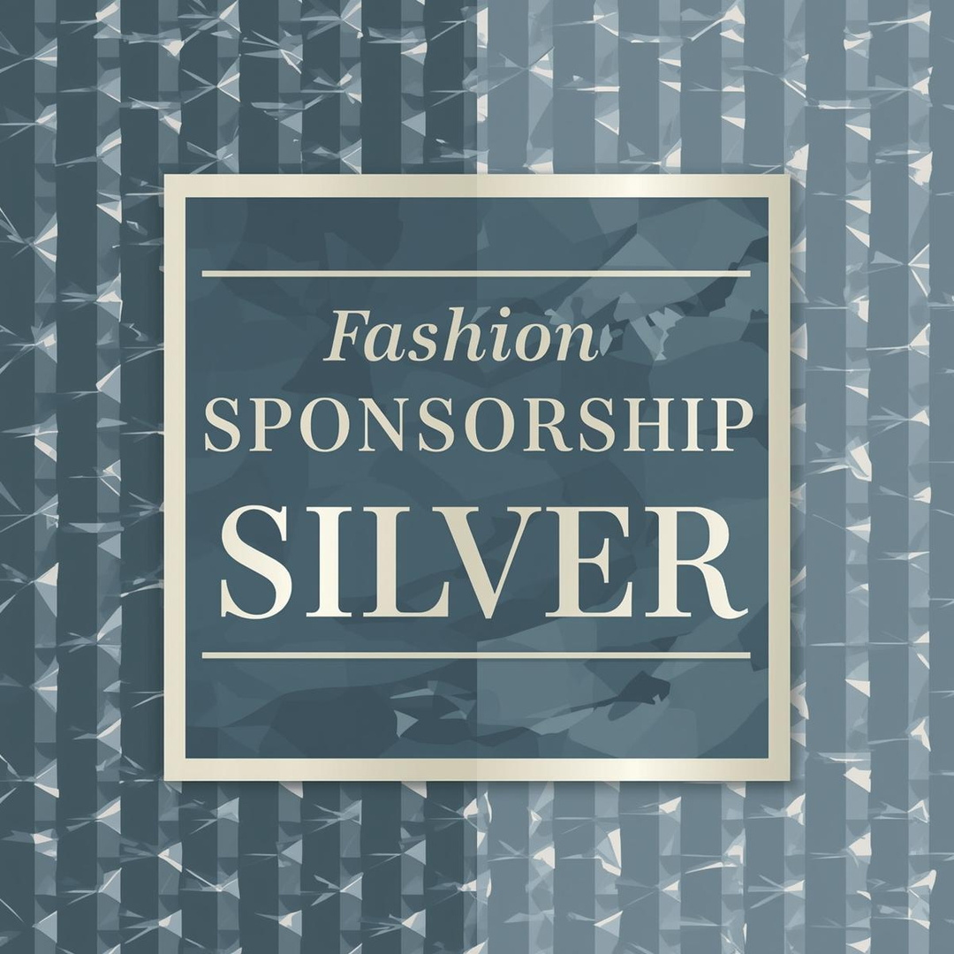
Sponsorship Tiers & Benefits
We offer tiered sponsorship packages designed to meet diverse branding, networking, and business objectives.
Silver Sponsor | Medium Investment
  ·Branding in designated zones (e.g., Deal Room, Networking Lounge)
  ·3 pre-scheduled buyer meetings
  ·Logo on event directory and digital screens
  2 VIP passes to Awards Gala
Ideal For
Emerging brands, tech platforms, and logistics partners.

Slide 10

Sponsorship Tiers & Benefits
We offer tiered sponsorship packages designed to meet diverse branding, networking, and business objectives.
Sector Partner | Custom Investment
  ·Sponsorship of a specific segment (e.g., Textile Pavilion, Sustainability Forum)
  ·Targeted branding for niche audience
  2 VIP passes to relevant sessions
Ideal For
Fabric mills, sustainable tech firms, and boutique service providers.

Slide 11
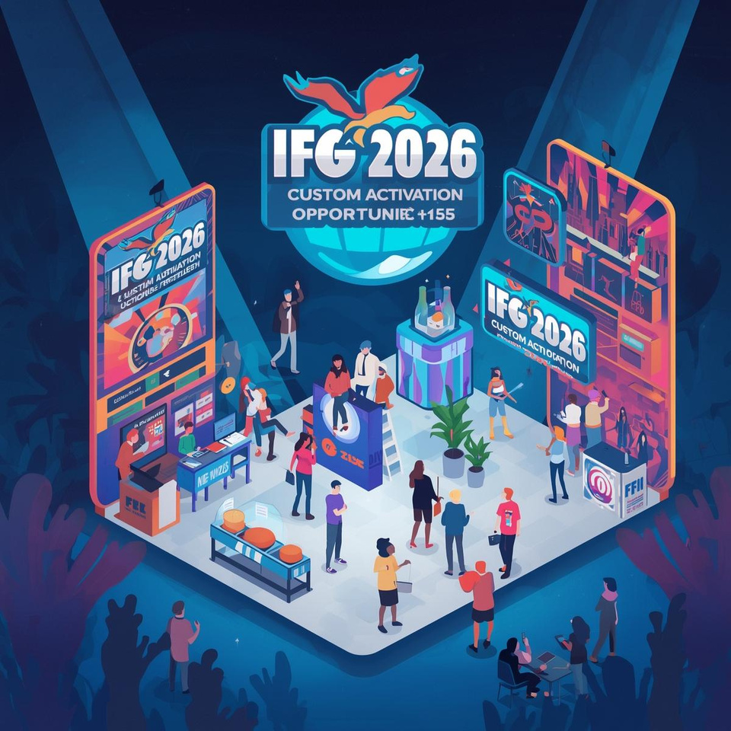
Custom Activation Opportunities
Beyond tiered packages, sponsors can activate through tailored experiences:
Runway Show Sponsorship:
Brand the “Best of IFG” runway or a dedicated regional showcase.
Awards Category Sponsorship:
Associate your brand with excellence (e.g., “Best Sustainable Design Award sponsored by [Your Brand]”).
VIP Lounge Hosting:
Create an exclusive space for networking with buyers and investors.
Digital Integration:
Sponsor the event app, virtual showrooms, or live-streamed sessions.

Slide 12
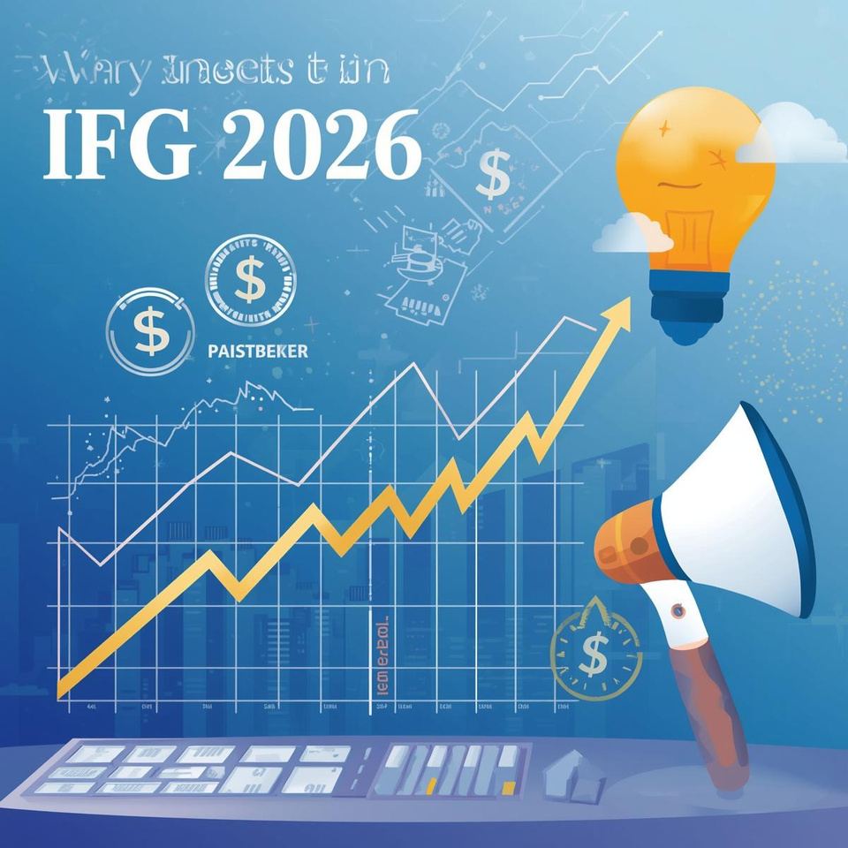
Why Invest in IFG 2026? The Sponsor’s ROI
Elite Brand Alignment
Associate with Saudi Arabia’s Vision 2030 and the future of fashion.
Direct Access to Decision-Makers
Engage with CEOs, investors, and buyers from the GCC’s top retail groups.
Media Amplification
Leverage coverage from Arab News, Fashion Commission channels, and international press.
Content & Credibility
Use award wins and runway footage in global marketing campaigns.
Long-Term Market Entry
Forge partnerships that facilitate physical presence in Saudi Arabia.

Slide 13
Digital Natives
Audience Insights
01.
Tech-savvy, socially active, and lifestyle-driven.
Strong Buying Power
02.
High purchasing power in F&B, fashion, and gadgets.
Understanding your potential customers builds stronger engagement with a trend-conscious and value-driven audience.
Value-Driven Engagement
03.
Actively engage with brands that align with their values.

Slide 14
Sponsorship Packages
Flexible packages designed to align with your brand’s goals and maximize visibility before, during, and after the event.
Tier | Package
Platinum Sponsor | 10000 USD
Gold Sponsor | 7500 USD
Silver Sponsor | 5000 USD
Customer Partner | 3000 USD

Slide 15
Next Steps:
Secure Your Partnership
To express interest or request a custom proposal:
Contact us
01.
for a detailed sponsorship prospectus and activation ideas.
IFG 2026 is currently finalizing partnerships with the Saudi Fashion Commission, major retail conglomerates, and media houses. Sponsorship slots are limited and will be allocated on a first-commit, first-served basis.
Schedule a call
02.
with our sponsorship team to align objectives.
Secure your tier
03.
by signing a memorandum of understanding (MOU).

Slide 16



Contact & Next Steps
Email
sponsorship@ifg-ksa.com
Phone
+966 55-097-4991
Let’s create an unforgettable experience together. Contact us to explore partnership possibilities tailored for your brand.
Website
www.ifg-ksa.com

